Slide 1


3.2 Binary Search Trees
BSTs
ordered operations
deletion
http://algs4.cs.princeton.edu

Slide 2
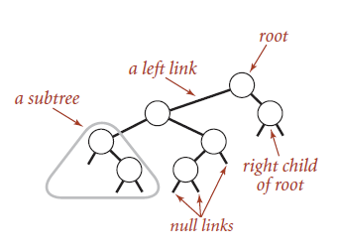
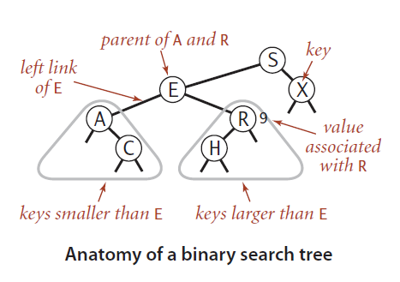
Binary search trees
Definition. A BST is a binary tree in symmetric order.
A binary tree is either:
Empty.
Two disjoint binary trees (left and right).
Symmetric order. Each node has a key, and every node’s key is:
Larger than all keys in its left subtree.
Smaller than all keys in its right subtree.
Remember: no duplicate keys
Notes:
Remember: no duplicate keys
We suppress values when convenient

Slide 3
Binary search tree demo
Search. If less, go left; if greater, go right; if equal, search hit.
successful search for H
S
E
X
A
R
C
H
M

Slide 4
Binary search tree demo
Search. If less, go left; if greater, go right; if equal, search hit.
compare H and S
(go left)
successful search for H
H
S
E
X
A
R
C
H
black nodes could
match the search key
M

Slide 5
Binary search tree demo
Search. If less, go left; if greater, go right; if equal, search hit.
successful search for H
compare H and E
(go right)
S
H
E
X
A
R
C
H
M

Slide 6
Binary search tree demo
Search. If less, go left; if greater, go right; if equal, search hit.
successful search for H
S
E
X
A
R
H
compare H and R
(go left)
C
H
M

Slide 7
Binary search tree demo
Search. If less, go left; if greater, go right; if equal, search hit.
successful search for H
S
E
X
A
R
C
H
H
compare H and H
(search hit)
M

Slide 8
Binary search tree demo
Search. If less, go left; if greater, go right; if equal, search hit.
unsuccessful search for G
S
E
X
A
R
C
H
M

Slide 9
Binary search tree demo
Search. If less, go left; if greater, go right; if equal, search hit.
compare G and S
(go left)
unsuccessful search for G
G
S
E
X
A
R
C
H
M

Slide 10
Binary search tree demo
Search. If less, go left; if greater, go right; if equal, search hit.
unsuccessful search for G
compare G and E
(go right)
S
G
E
X
A
R
C
H
M

Slide 11
Binary search tree demo
Search. If less, go left; if greater, go right; if equal, search hit.
unsuccessful search for G
S
E
X
A
R
G
compare G and R
(go left)
C
H
M

Slide 12
Binary search tree demo
Search. If less, go left; if greater, go right; if equal, search hit.
unsuccessful search for G
S
E
X
A
R
C
H
G
compare G and H
(go left)
M

Slide 13
Binary search tree demo
Search. If less, go left; if greater, go right; if equal, search hit.
unsuccessful search for G
S
E
X
A
R
C
H
G
M
no more tree
(search miss)

Slide 14
Binary search tree demo
Insert. If less, go left; if greater, go right; if null, insert.
insert G
S
E
X
A
R
C
H
M

Slide 15
Binary search tree demo
Insert. If less, go left; if greater, go right; if null, insert.
compare G and S
(go left)
insert G
G
S
E
X
A
R
C
H
M

Slide 16
Binary search tree demo
Insert. If less, go left; if greater, go right; if null, insert.
insert G
compare G and E
(go right)
S
G
E
X
A
R
C
H
M

Slide 17
Binary search tree demo
Insert. If less, go left; if greater, go right; if null, insert.
insert G
S
E
X
A
R
G
compare G and R
(go left)
C
H
M

Slide 18
Binary search tree demo
Insert. If less, go left; if greater, go right; if null, insert.
insert G
S
E
X
A
R
C
H
G
compare G and H
(go left)
M

Slide 19
Binary search tree demo
Insert. If less, go left; if greater, go right; if null, insert.
insert G
S
E
X
A
R
C
H
G
M
no more tree
(insert here)

Slide 20
Binary search tree demo
Insert. If less, go left; if greater, go right; if null, insert.
insert G
S
E
X
A
R
C
H
G
G
M
no more tree
(insert here)

Slide 21
Binary search tree demo
Insert. If less, go left; if greater, go right; if null, insert.
insert G
S
E
X
A
R
C
H
G
M

Slide 22
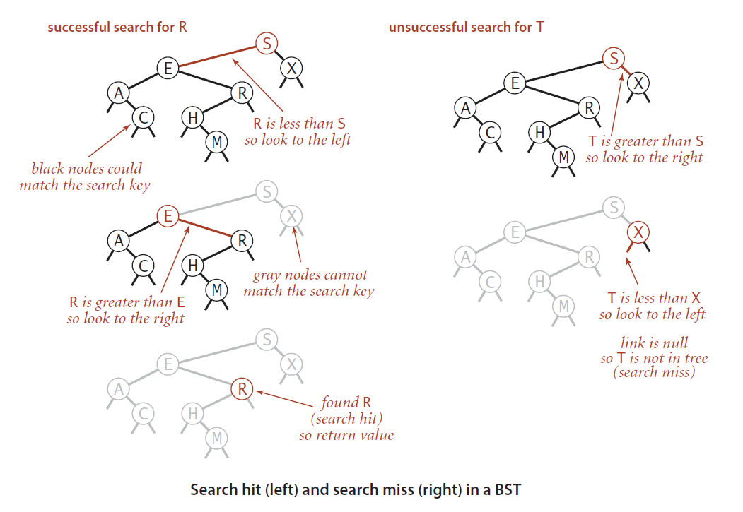
BST search
Get. Return value corresponding to given key, or null if no such key.

Slide 23
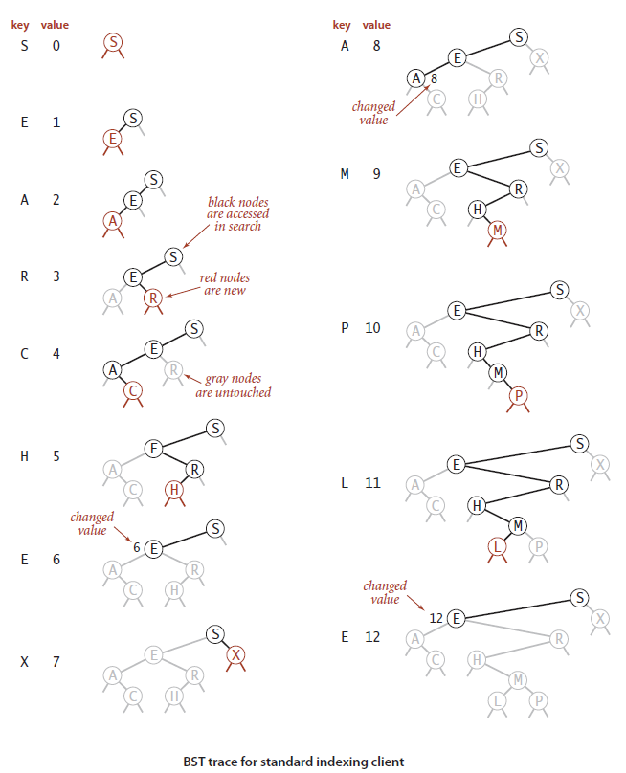
BST Operations

Slide 24
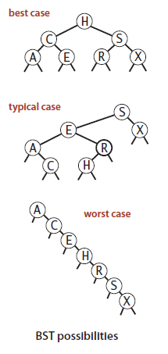
BST cases

Slide 25
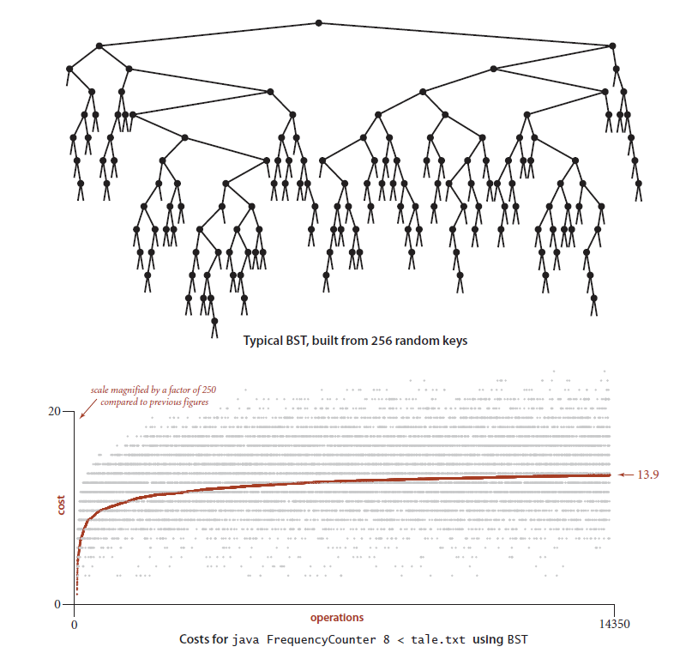
BST cases

Slide 26
BST representation in C++

Slide 27
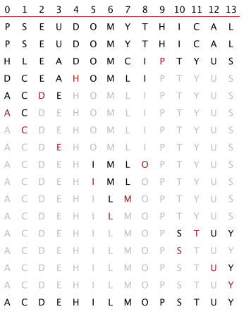
Correspondence between BSTs and quicksort partitioning
Remark. Correspondence is 1–1 if array has no ____________.
P
H
T
D
O
S
U
A
E
I
Y
C
M
L

Slide 28
Correspondence between BSTs and quicksort partitioning
Remark. Correspondence is 1–1 if array has no duplicate keys.
P
H
T
D
O
S
U
A
E
I
Y
C
M
L

Slide 29
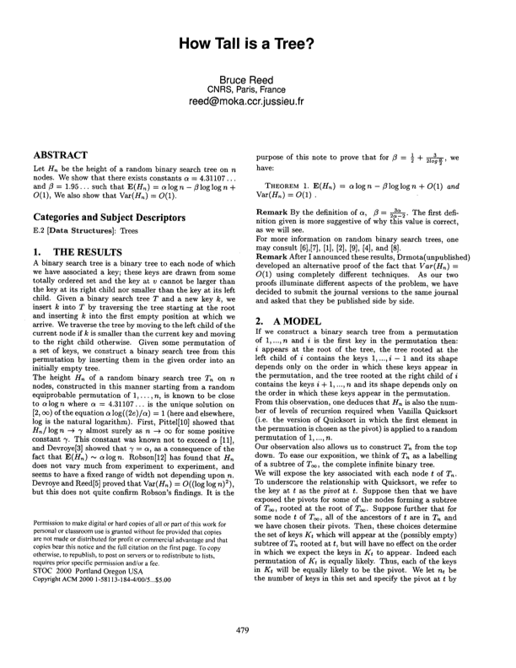
BSTs: mathematical analysis
Proposition. If N distinct keys are inserted into a BST in random order, the expected number of compares for a search/insert is ∼ 2 ln N.
Pf. 1–1 correspondence with quicksort partitioning.
Proposition. [Reed, 2003] If N distinct keys are inserted in random order, expected height of tree is ∼ 4.311 ln N.
But… Worst-case height is N – 1. [ exponentially small chance when keys are inserted in random order ]
Notes:
variance = O(1) for both propositions
worst case = keys inserted in ascending order
Reference: The Height of a Random Binary Search Tree by Bruce Reed, JACM 2003
4.311 ln N - 1.953 ln ln N

Slide 30
ST implementations: summary
implementation | guarantee |  | average case |  | operations on keys
 | search | insert | search hit | insert
sequential search (unordered list) | N | N | ½ N | N | equals()
binary search (ordered array) | lg N | N | lg N | ½ N | compareTo()
BST | N | N | 1.39 lg N | 1.39 lg N | compareTo()
Why not shuffle to ensure a (probabilistic) guarantee of 4.311 ln N?
Notes:
Note: we don't consider 4.311 ln N a (probabilistic) guarantee because it makes a strong assumption about the input distribution (that it is a uniformly random permutation of the input data) AND we cannot shuffle to ensure this assumption if we don’t have all the data up front.

Slide 31
3.2 Binary Search Trees
deletion
http://algs4.cs.princeton.edu

Slide 32
ST implementations: summary
Next. Deletion in BSTs.
implementation | guarantee |  |  | average case |  |  | ordered ops? | operations on keys
 | search | insert | delete | search hit | insert | delete
sequential search (linked list) | N | N | N | ½ N | N | ½ N |  | equals()
binary search (ordered array) | lg N | N | N | lg N | ½ N | ½ N | ✔ | compareTo()
BST | N | N | N | 1.39 lg N | 1.39 lg N | ? ? ? | ✔ | compareTo()

Slide 33
BST deletion: lazy approach
To remove a node with a given key:
Set its value to null.
Leave key in tree to guide search (but don't consider it equal in search).
Cost. ~ 2 ln N' per insert, search, and delete (if keys in random order), where N' is the number of key-value pairs ever inserted in the BST.
Unsatisfactory solution. Tombstone (memory) overload.
E
E
A
S
A
S
delete I
C
I
C
☠
tombstone
H
R
H
R
N
N

Slide 34
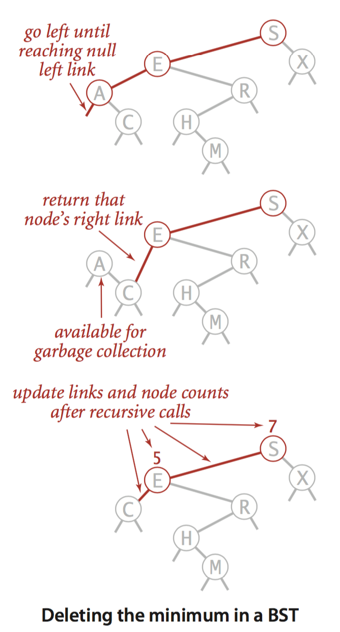
Deleting the minimum
To delete the minimum key:
Go left until finding a node with a null left link.
Replace that node by its right link.
Update subtree counts.
public void deleteMin()
{ root = deleteMin(root); }
private Node deleteMin(Node x)
{
if (x.left == null) return x.right;
x.left = deleteMin(x.left);
x.count = 1 + size(x.left) + size(x.right);
return x;
}
Notes:
compact recursive solution

Slide 35
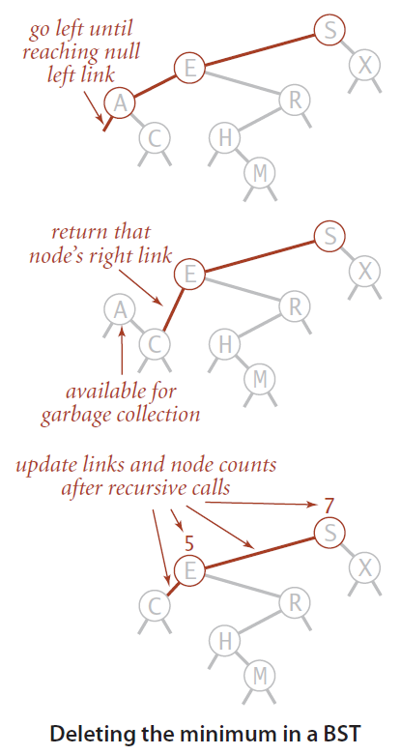
Hibbard deletion
To delete a node with key k: search for node t containing key k.
Case 0. [0 children] Delete t by setting parent link to null.

Slide 36
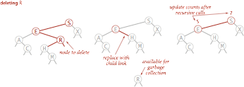
Hibbard deletion
To delete a node with key k: search for node t containing key k.
Case 1. [1 child] Delete t by replacing parent link.

Slide 37
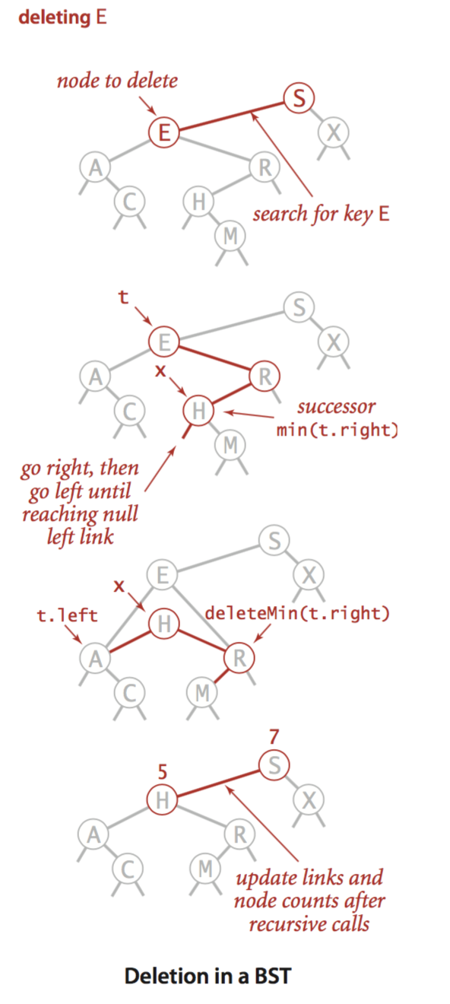
Hibbard deletion
To delete a node with key k: search for node t containing key k.
Case 2. [2 children]
Find successor x of t.
Delete the minimum in t's right subtree.
Put x in t's spot.
x has no left child
but don't garbage collect x
still a BST
Notes:
replace node with successor; delete node as it now has at most 1 child

Slide 38
Hibbard deletion: Implementation
void BST::del(string key) { root = del(root, key); }
Node* BST::del(Node* x, string key)
{
if (x == NULL) return NULL;
if (key == x->key)
{
if (x->right == NULL) return x->left;
if (x->left == NULL) return x->right;
Node* t = x;
x = min(t->right);
x->right = deleteMin(t->right);
x->left = t->left;
}
else if (key < x->key) { x->left = del(x->left, key); }
else if (key > x->key) { x->right = del(x->right, key); }
x->N = 1 + size(x->left) + size(x->right);
return x;
}
search for key
no right child
no left child
replace with successor
update subtree counts
Notes:
don't spend too much time here
[wayne f12] Note: we change the links of every node on the path from the root to the deleted node (as in insert).

Slide 39
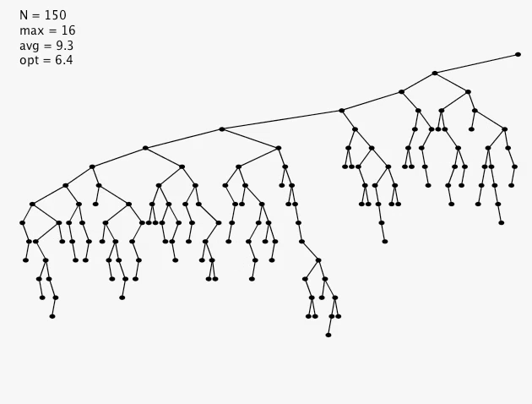
Hibbard deletion: analysis
Unsatisfactory solution. Not symmetric.
Surprising consequence. Trees not random (!)
Longstanding open problem. Simple and efficient delete for BSTs.
Notes:
animation: insert 255 random values; repeat 255 times: delete random, insert random, then display
quite a surprise to many (including Hibbard) when it was first discovered
Culberson-Munro: average internal path length is N^½. They prove that the leftmost spine gets elongated (as it does in the video).
Hibbard = person credited with deletion strategy
Conjecture (that I think is still unresolved): symmetric version of Hibbard deletion leads to O(log N) performance

Slide 40
ST implementations: summary
Next lecture. Guarantee logarithmic performance for all operations.
implementation | guarantee |  |  | average case |  |  | ordered ops? | operations on keys
 | search | insert | delete | search hit | insert | delete
sequential search (linked list) | N | N | N | ½ N | N | ½ N |  | equals()
binary search (ordered array) | lg N | N | N | lg N | ½ N | ½ N | ✔ | compareTo()
BST | N | N | N | 1.39 lg N | 1.39 lg N | √ N | ✔ | compareTo()
other operations also become √N
if deletions allowed

Slide 41
3.2 Binary Search Trees
BSTs
ordered operations
deletion
http://algs4.cs.princeton.edu

Slide 42
3.2 Binary Search Trees
BSTs
ordered operations
deletion
http://algs4.cs.princeton.edu

Slide 43
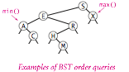
Minimum and maximum
Minimum. Smallest key in table.
Maximum. Largest key in table.
Q. How to find the min / max?
max
min
Notes:
Follow leftmost or rightmost spine.
Running time is proportional to depth of node.

Slide 44
Floor and ceiling
Floor. Largest key ≤ a given key.
Ceiling. Smallest key ≥ a given key.
Q. How to find the floor / ceiling?
floor(G)
ceiling(Q)
floor(D)
Notes:
Approach 1. Search for key; floor and ceiling on search path.
Running time is bounded by height of tree.

Slide 45
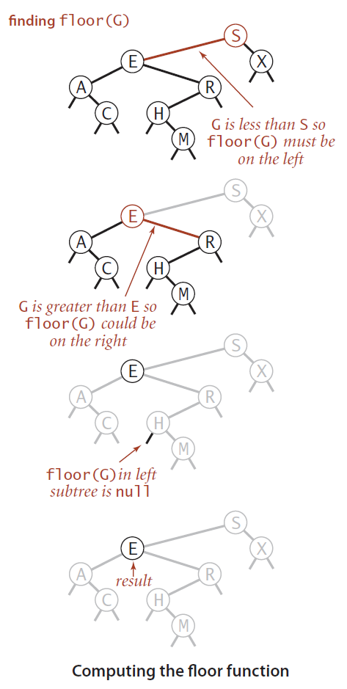
Computing the floor
Case 1. [k equals the key in the node] The floor of k is k.
Case 2. [k is less than the key in the node] The floor of k is in the left subtree.
Case 3. [k is greater than the key in the node] The floor of k is in the right subtree (if there is any key ≤ k in right subtree); otherwise it is the key in the node.
Notes:
[wayne] perhaps just trace with figure first, then reveal cases.

Slide 46
Computing the floor
public Key floor(Key key) { Node x = floor(root, key); if (x == null) return null; return x.key; }
private Node floor(Node x, Key key) { if (x == null) return null; int cmp = key.compareTo(x.key);
if (cmp == 0) return x;
if (cmp < 0) return floor(x.left, key);
Node t = floor(x.right, key); if (t != null) return t; else return x;
}

Slide 47
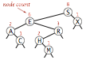
Rank and select
Q. How to implement rank() and select() efficiently?
A. In each node, we store the number of nodes in the subtree rooted at that node; to implement size(), return the count at the root.

Slide 48
BST implementation: subtree counts
private class Node
{
private Key key;
private Value val;
private Node left;
private Node right;
private int count;
}
public int size()
{ return size(root); }
private int size(Node x)
{
if (x == null) return 0;
return x.count;
}
ok to call
when x is null
number of nodes in subtree
private Node put(Node x, Key key, Value val)
{
if (x == null) return new Node(key, val, 1);
int cmp = key.compareTo(x.key);
if (cmp < 0) x.left = put(x.left, key, val);
else if (cmp > 0) x.right = put(x.right, key, val);
else if (cmp == 0) x.val = val;
x.count = 1 + size(x.left) + size(x.right);
return x;
}
initialize subtree
count to 1
Notes:
constant amount of extra work per function call
there are a few ways to update the count field. The approach we take generalizes to more general situations as we will see next lecture (e.g., rotations).

Slide 49
Rank
Rank. How many keys < k ?
Easy recursive algorithm (3 cases!)
public int rank(Key key)
{ return rank(key, root); }
private int rank(Key key, Node x)
{
if (x == null) return 0;
int cmp = key.compareTo(x.key);
if (cmp < 0) return rank(key, x.left);
else if (cmp > 0) return 1 + size(x.left) + rank(key, x.right);
else if (cmp == 0) return size(x.left);
}
Notes:
Running time is bounded by height of tree.

Slide 50
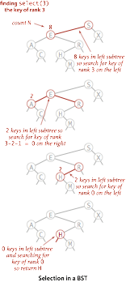
Selection
Select. Key of given rank.
public Key select(int k)
{
if (k < 0) return null;
if (k >= size()) return null;
Node x = select(root, k);
return x.key;
}
private Node select(Node x, int k)
{
if (x == null) return null;
int t = size(x.left);
if (t > k)
return select(x.left, k);
else if (t < k)
return select(x.right, k-t-1);
else if (t == k)
return x;
}

Slide 51
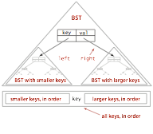
Inorder traversal
Traverse left subtree.
Enqueue key.
Traverse right subtree.
Property. Inorder traversal of a BST yields keys in ascending order.
public Iterable<Key> keys()
{
Queue<Key> q = new Queue<Key>();
inorder(root, q);
return q;
}
private void inorder(Node x, Queue<Key> q)
{
if (x == null) return;
inorder(x.left, q);
q.enqueue(x.key);
inorder(x.right, q);
}
Notes:
linear time to iterate over all keys

Slide 52
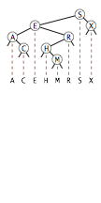
Inorder traversal
Traverse left subtree.
Enqueue key.
Traverse right subtree.
inorder(S)
inorder(E)
inorder(A)
enqueue A
inorder(C)
enqueue C
enqueue E
inorder(R)
inorder(H)
enqueue H
inorder(M)
enqueue M
enqueue R
enqueue S
inorder(X)
enqueue X
A
C
E
H
M
R
S
X
S
S E
S E A
S E A C
S E R
S E R H
S E R H M
S X
recursive calls
queue
function call stack

Slide 53
BST: ordered symbol table operations summary
 | Sequential search | Binary search | BST
search | N | lg N | h
insert | N | N | h
min / max | N | 1 | h
floor / ceiling | N | lg N | h
rank | N | lg N | h
select | N | 1 | h
ordered iteration | N log N | N | N
h = height of BST (proportional to log N if keys inserted in random order)
order of growth of running time of ordered symbol table operations

Slide 54
3.2 Binary Search Trees
BSTs
ordered operations
deletion
http://algs4.cs.princeton.edu

Slide 55
3.2 Binary Search Trees
BSTs
ordered operations
deletion
http://algs4.cs.princeton.edu

Slide 56

3.2 Binary Search Trees
Algorithms
Robert Sedgewick | Kevin Wayne
BSTs
ordered operations
deletion
http://algs4.cs.princeton.edu

